Slide 1



LABOUR MARKET
Industrialization, Globalization and Labour

Slide 2
Introduction to Labour Market
The labour market is an example of a factor market
Supply of labour – those who are seeking employment (employees)
Demand for labour – from employers
Labour markets function through the interaction of workers and employers.
  A ‘Derived Demand’ – not wanted for its own sake but for what it can contribute to production
  Demand for labour related to productivity of labour and the level of demand for the product
  Elasticity of demand for labour related to
  the elasticity of demand for the product

Slide 3
Introduction to the Labour Market
It’s a market in which workers compete for jobs and employers compete for workers.
It’s a nominal market in which workers find paying work , employers find willing workers.
This market may be local ,national or international in its scope and are made up of different qualification, skills and geographical locations.

Slide 4
Labour Market Dependency
This market depends on
wage rates,
condition of employment ,
level of competition ,
exchange of information between employers and job seekers, and
job location etc.

Slide 5
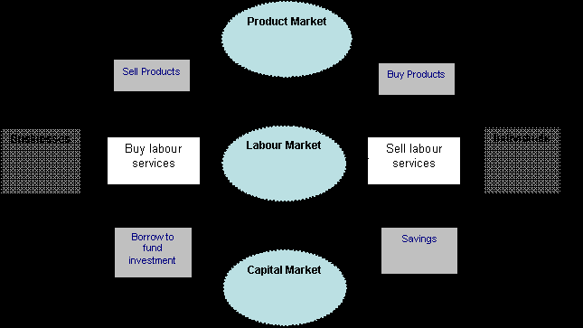
Labour Market inter-connection with Other Markets

Slide 6
Demand for labour
The firms who sold goods and services are the buyers in the labor market.
Firms need workers
to make and design products,
pack and sell them,
advertise for them,
ship them, and distribute them.
No worker will do this for free, and so firms must enter into the labour market and buy labour.
Firms determine the amount of labour
that they demand according to several considerations: labour cost (as represented by the market wage), and the need.

Slide 7
MRP and labour
The marginal revenue product is the extra revenue a firm generates when they buy one more unit of labour.
the marginal revenue product (MRP) of labor is equal to the market wage.
MRP > w : The firm will buy more labour
MRP = w : The firm is buying the right amount of Labour
MRP < w : The firm is buying too much labor

Slide 8
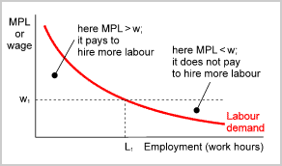
The labour demand curve is a graph, indicating in a wage/employment diagram how much work (measured in work hours) firms demand at different wage rates. The curve is negatively sloping, meaning that firms want to cut down on employment if work becomes more expensive.

Slide 9
Supply of Labour
The labour supply refers to the total number of hours that labour is willing and able to supply at a given wage rate.
It can also be defined as the number of workers willing and able to work in a given occupation or industry for a given wage

Slide 10
Cont.
The Supply of Labour
The amount of people offering their labour at different wage rates.
  Involves an opportunity cost – work v. leisure
  Wage rate must be sufficient
  to overcome the opportunity cost
  of leisure

Slide 11
Cont.
Income effect of a rise in wages:
  As wages rise, people feel better off and therefore may not feel a need to work as many hours
Substitution effect of a rise in wages:
  As wages rise, the opportunity cost of leisure rises (the cost of every extra hour taken in leisure rises). As wages rise, the substitution effect may lead to more hours being worked.
The net effect depends on the relative strength of the income and substitution effects

Slide 12
Geographical Mobility of Labour
  The willingness of people to move
  The cost and availability of housing
  in different areas
  The extent of social, cultural and family ties
  The amount of information available to workers about jobs in other areas
  The cost of re-location
  Anxiety of the idea of re-location

Slide 13
Occupational Mobility of Labour
  Lack of information of available jobs in other occupations
  Extent and quality of remuneration packages
  Extent of skills and qualifications
  to do the job
  Anxiety at changing jobs

Slide 14
Key factors affecting labour supply
The supply of labour to a particular occupation is influenced by a range of monetary and non-monetary considerations.
The real wage rate on offer in the industry
Overtime
Substitute occupations
Barriers to entry

Slide 15
Supply of Work Hours
A worker will initially increase the supply of a number of hours of work with a rise in the rate of wages.
Once his/her estimated need of wage income is satisfied he is likely to prefer leisure or rest from work.
Leisure is an attractive alternative to work and hence it is the opportunity cost at further hikes in the wage rate. This has been shown in Figure in the next PPT.

Slide 16
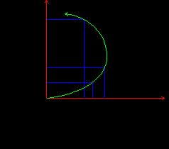
Backward Sloping Supply: The labour supply curve of a single worker may not be smooth and straight. It is likely to be backward bending or sloping in nature.

